Slide 1


Taking back control
Seb Tucknott
Living with ulcerative colitis
Notes:
Good morning, thank you for inviting me to speak to you today. I’m Seb and I’d like to give you a small insight into what it’s like living with inflammatory bowel disease and why health research from home is such an important topic.

Slide 2
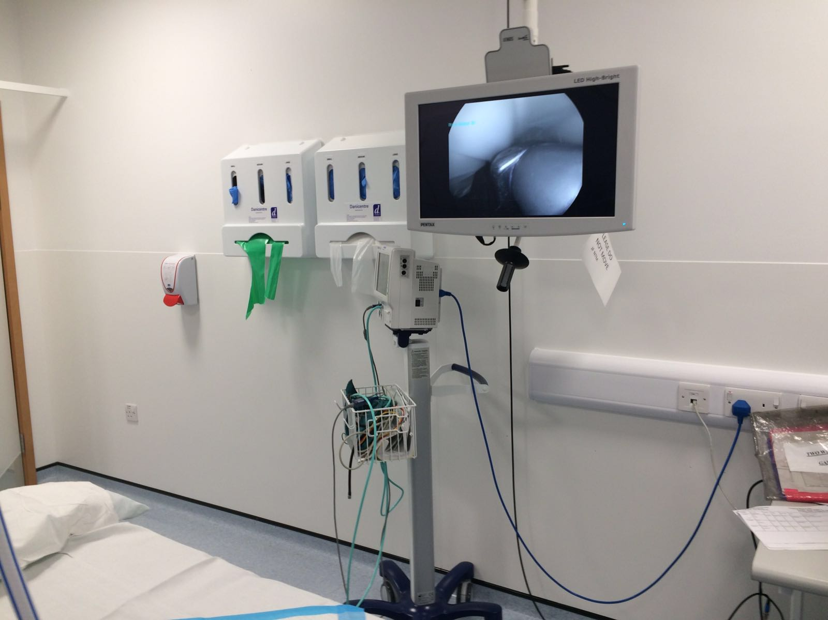
My story
Pic of Seb
DX 2008 etc etc
Notes:
To take you back to the beginning, 17 years ago this was my view in the endoscopy suite waiting to have a colonoscopy.
3 weeks prior to this I had been to the toilet and I saw blood in my poo. Things went downhill very quickly and by the third week I was rushing to the toilet 30-40 times day and night, I had lost nearly 10 kilos and I was severely dehydrated.
I was rushed into hospital where I was diagnosed with ulcerative colitis, a form of inflammatory bowel disease or IBD (not IBS!). My condition was very severe and I was very close to requiring emergency surgery to remove my colon.
Fortunately for me the treatments were able to get things under control and I left hospital 9 days late still in one piece.
For those of you not familiar with IBD, it’s a chronic life long condition where your immune system for some unknown reason causes inflammation in your digestive tract. There are two main types, Crohn’s disease which can affect anywhere from your mouth to your bottom and ulcerative colitis which affects the colon and rectum.
It affects over 600,000 people in the UK and they’re commonly diagnosed in their 20s but it can develop at any age and there is a growing number of children being diagnosed.

Slide 3
Ulcerative colitis + Treatment = Cure
Disease
Notes:
As a nieve 21 year old with no experience of healthcare, I believed this is how health worked.
You get diagnosed with a disease, you get given a treatment and then you’re cured. Job done, everybody is happy!

Slide 4
Diagnosis
Health
Months
Notes:
I soon realised that this was very much not the case. My health would fluctuate significantly. I never really had things under control.
I’d be on high levels of treatment, the number of times I’d have to go to the toilet would reduce, the bleeding would stop and I’d start to feel better but never 100%. I still had debilitating fatigue alongwith side effects from the medications.
Then something would happen and I’d flare again, back to having no control over my bowels and would be running to toilet constantly. My anxiety was very high, leaving the house was terrifying with the fear that I wouldn’t be able to find a toilet or make it in time.
To give you an idea of how challenging that was, there would be times at home where with no warning you need the toilet, I sometimes wouldn’t even be able to make it upstairs and soil myself.
Imagine what it it like to catch a busy train or stand up on stage in front of 100s of people. 10, 15 years ago I would never believe that I’d be able to catch a rush hour train to London to go and stand on stage in front of people!
The lack of control was horrible. Every day not knowing how you’re going to be. And this is the case for some many people living with IBD and other long term conditions.
It had a huge impact on my life, I was reluctant to socialise, go on holidays even exercising was a struggle. I genuinely feel like I lost my 20s, I just existed and got through each day.

Slide 5
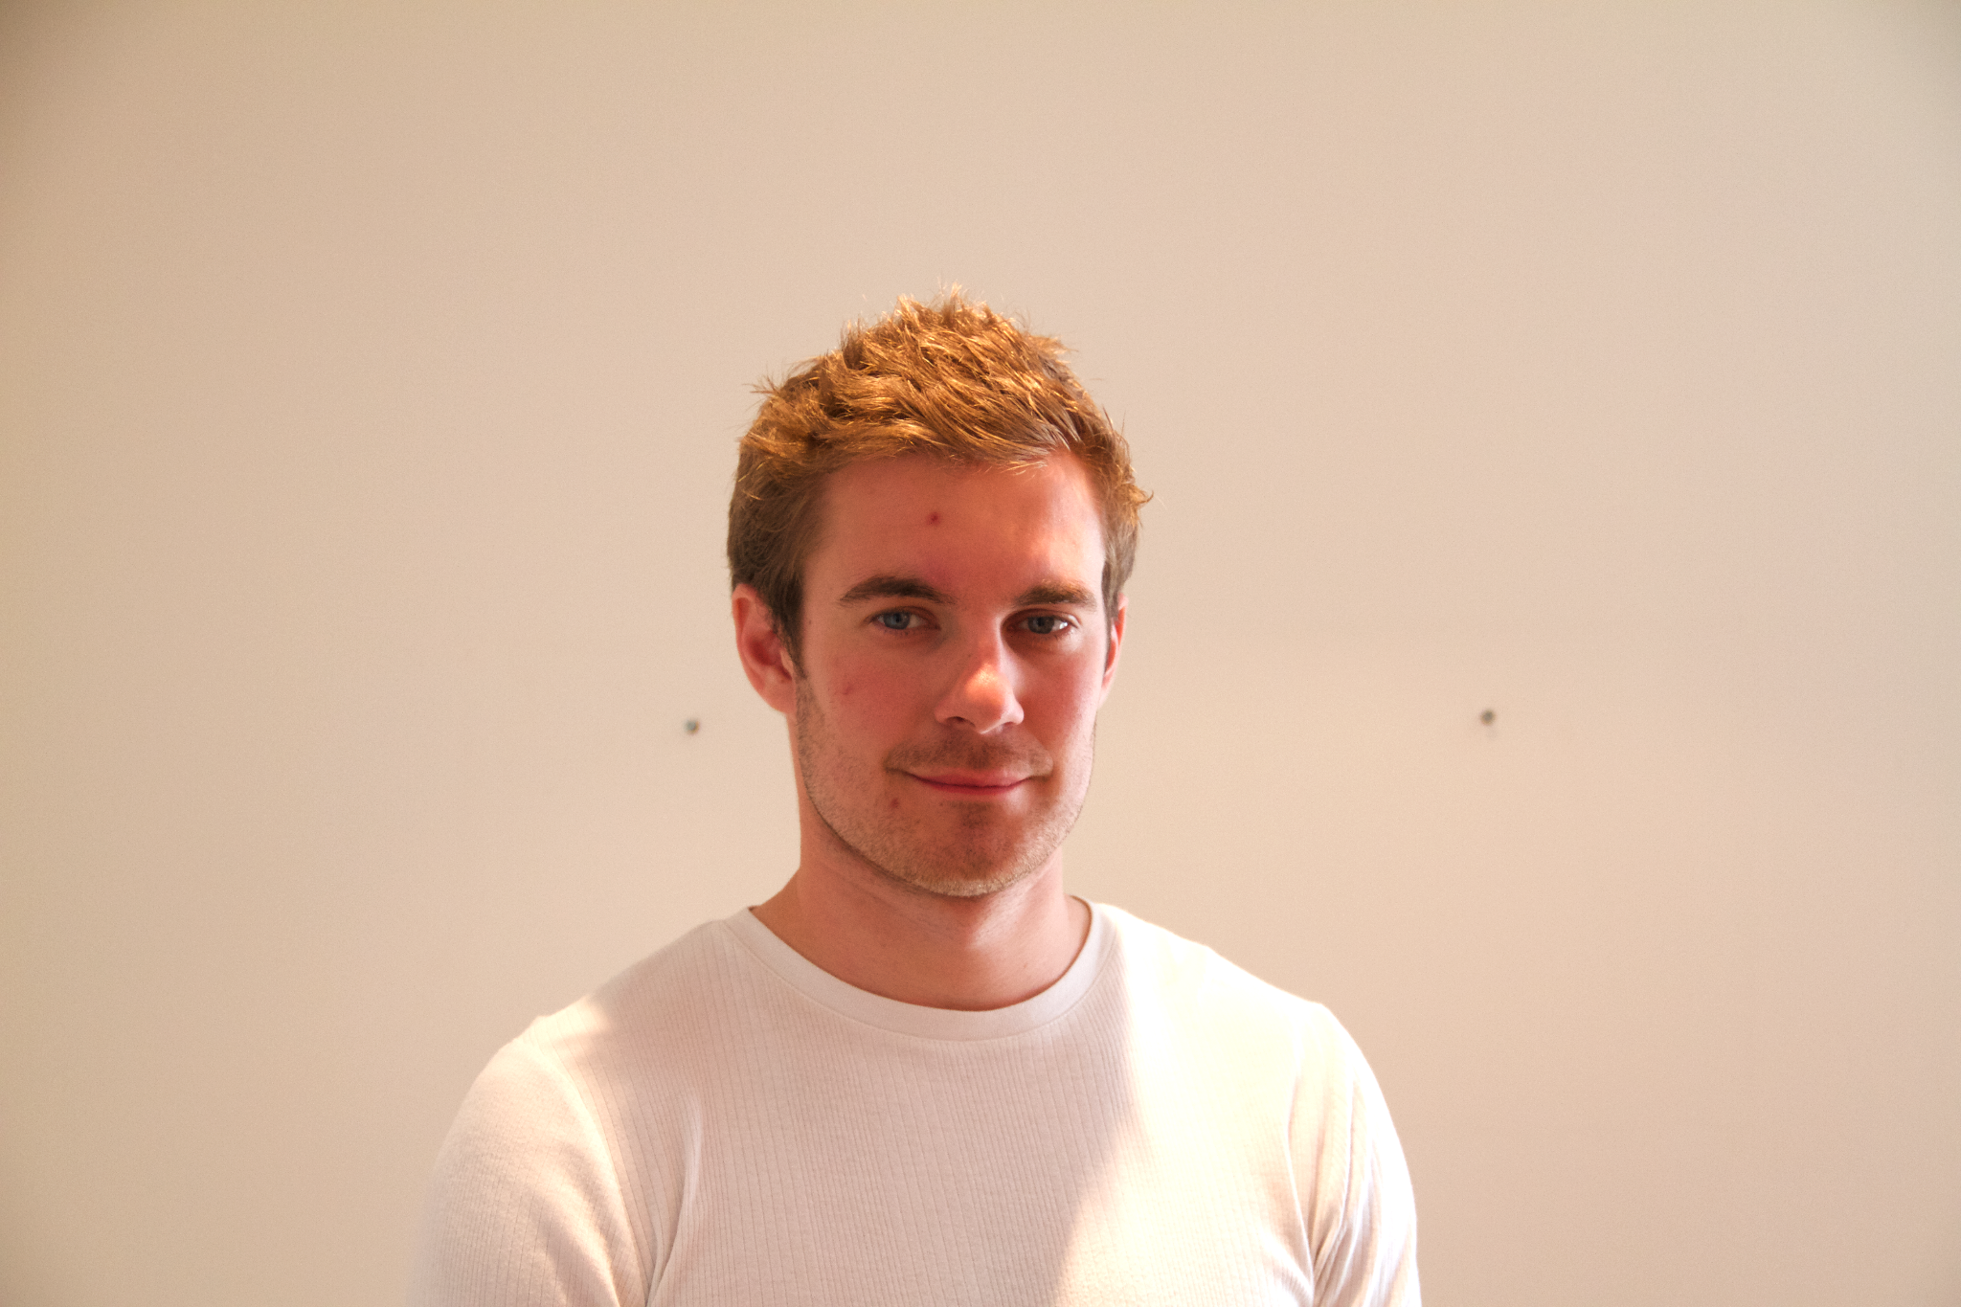

Notes:
This is a headshot from when I was 25, you can see the puffy cheeks and bad skin from prolonged steroid use. My eye were small and fatigued. My health was a mess.

Slide 6
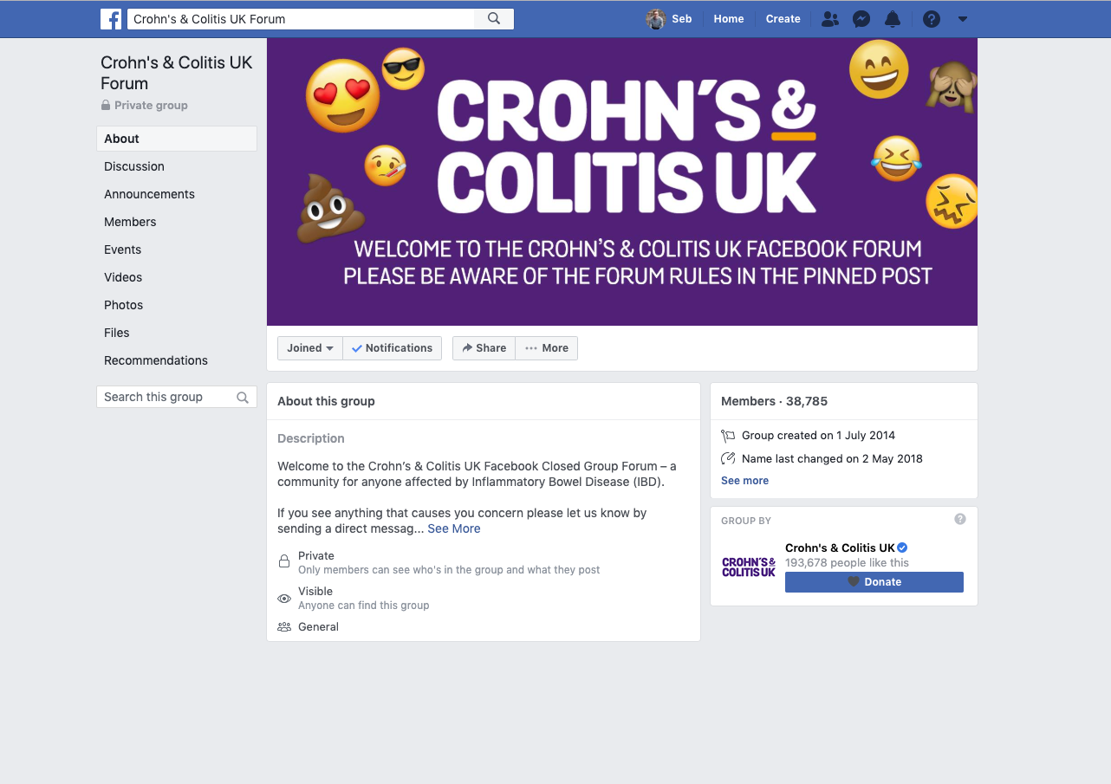
Facebook group
Notes:
The turning point for me was joining the Crohn’s and Colitis UK Facebook group. It was here for the first time I met other people living with IBD like me.
It opened my eyes up to how many others were struggling like me and how many different challenges people had. But there was also people sharing different ideas on how to improve their health and quality of life.
It was the first time I came to the realisation that maybe I could have some control, it wasn’t just up to the doctors, maybe I could do something to help myself too.

Slide 7
Ulcerative colitis + Treatment = Cure
Good quality of life
Medications
Stress management
Sleep
Movement
Diet
Happiness
Purpose
Notes:
Fast forward 10 years, I don’t believe this is the case anymore.
Treatment is so much more than medications, of course treatment they are very important but there are also 100s if not 1000s of other things I can do to help improve my health.
I must admit I became quite obsessed with biohacking, what little things could I do to further improve my health and my life.
Things like how I could reduce or change my relationship with stress, I bought an Oura ring, realised that although I was sleeping 9-10 hours a night my quality was around 50%. I worked hard to learn and improve it.
All this little incremental changes all added up and made a massive difference.
This is why I believe there are huge opportunities for health research at home. Health and people are complex. What’s going on 24/7 that could be positively or negatively affecting health?
Like Max alluded to in his talk, that annual 15 min snapshot is tiny compared to the other over 500,000 minutes in the year.

Slide 8
Diagnosis
Health
Years
Notes:
I feel fortunate to say that my health curve now looks like this. I feel the best I’ve ever done in my life and I don’t think I’m at the peak yet! My dream is everyone diagnosed with a long term condition can achieve this too and I believe that’s possible, especially with all the research happening, probably even in this room.
I’d like to emphasise that it is so important to spend time understanding your patients/users, the can help you understand subtle things that you might not have thought about which will be the success or failure of your project

Slide 9

Notes:
I’d like to close with this photo from 3 years ago. I had the honour of winning silver for the GB Master relay team.
I’d have never believed this would be remotely possible when I was diagnosed with ulcerative colitis. I hope it inspires others that are really struggling like I once was too.
Thank you.

